Slide 2
Presents

Slide 3
The Arduino IDE
The Arduino IDE, or Integrated Development Environment, is a piece of software installed on your computer which you use to write programs, or sketches as they are called, and upload them to your Arduino board
The Arduino IDE is available for Windows, Mac OS X and Linux - including the Raspberry Pi!

Slide 4
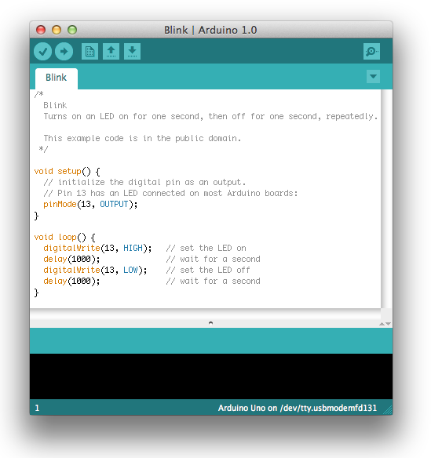
Testing The Arduino IDE
5) Open the Arduino application by double clicking on the icon
6) Open the “blink” sketch by clicking on
File > Examples > 1.Basics > Blink

Slide 5
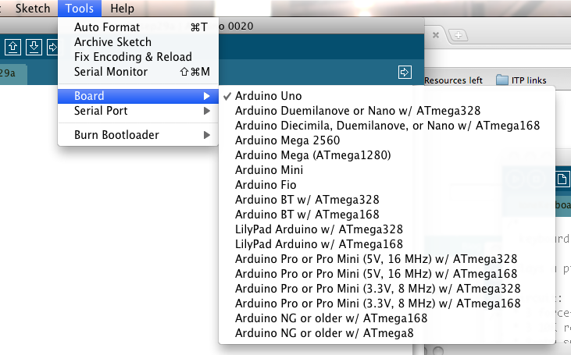
Testing The Arduino IDE
7) Select your board from the Tools > Board menu so the IDE knows which board it is talking to

Slide 6

Testing The Arduino IDE
8) Select the serial device of the Arduino board from the Tools > Serial Port menu. This is likely to be COM3 or higher. To find out, you can disconnect your Arduino board and re-open the menu; the entry that disappears should be the Arduino board. Reconnect the board and select that serial port.
9) Click the upload button. If the upload is successful, the message "Done uploading." will appear in the status bar.

Slide 7
Testing The Arduino IDE
A few seconds after the upload finishes, you should see the pin 13 (L) LED on the board start to blink (in orange). If it does, congratulations! You've gotten Arduino up-and-running, connected your board and uploaded your first sketch!
This is the LED connected to pin 13

Slide 8
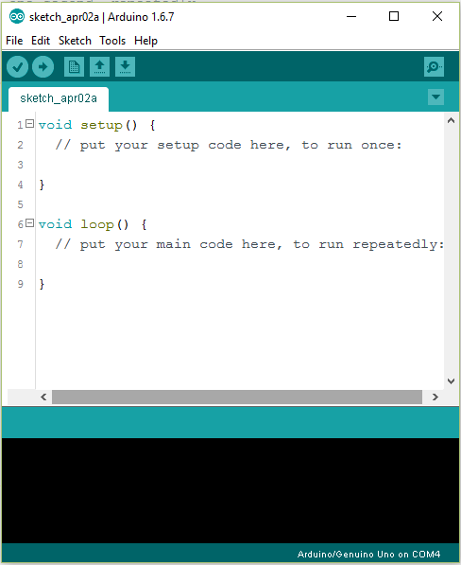
Structure of a basic Sketch

Slide 9
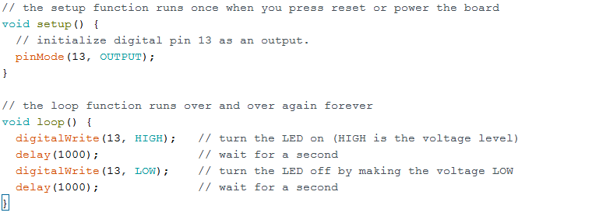
Understanding the Blink sketch

Slide 10
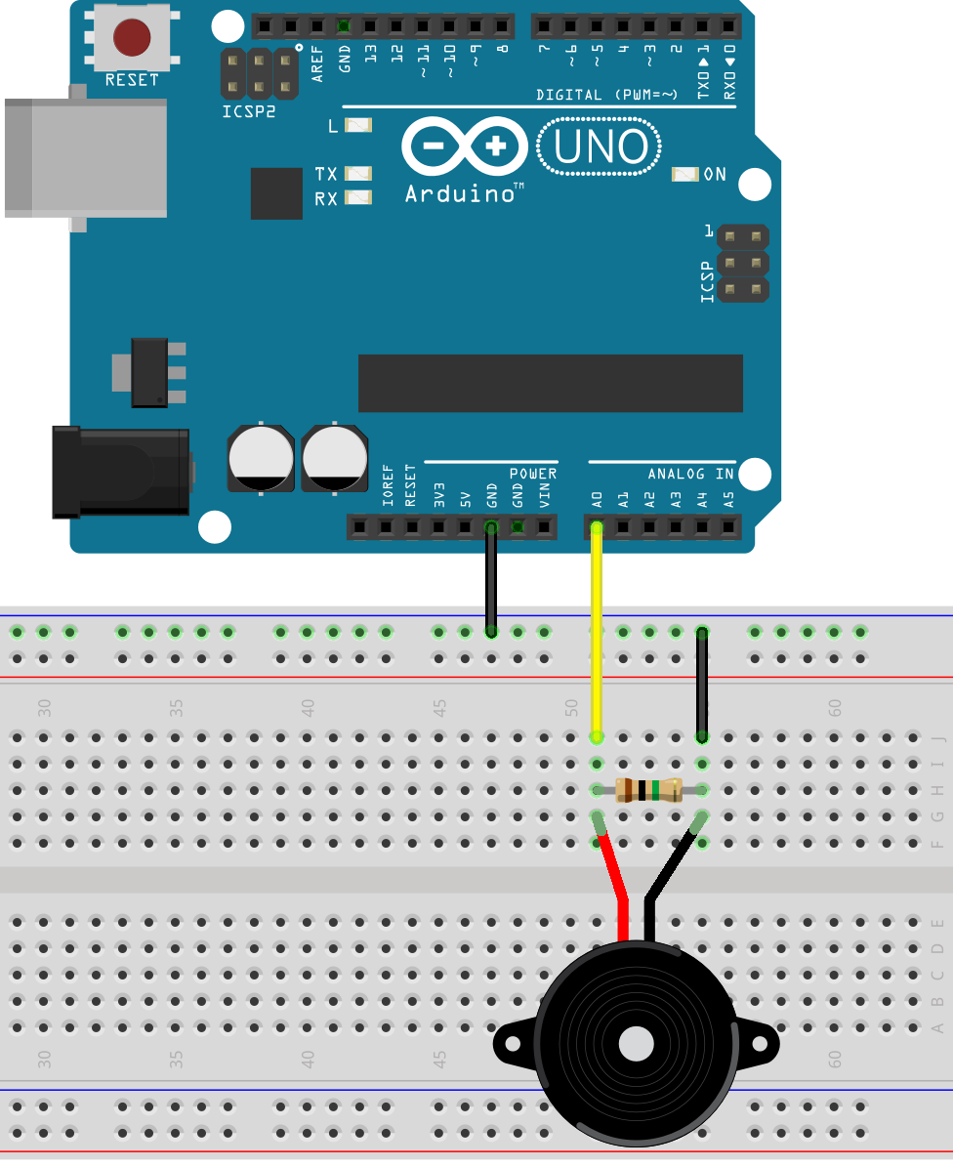
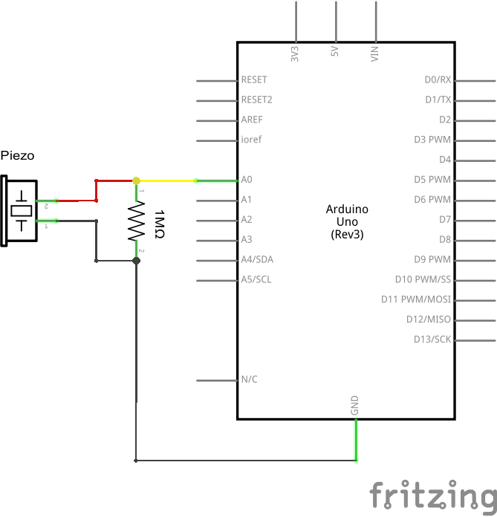
Analogue in and Serial out: Knock Sensor

Slide 12
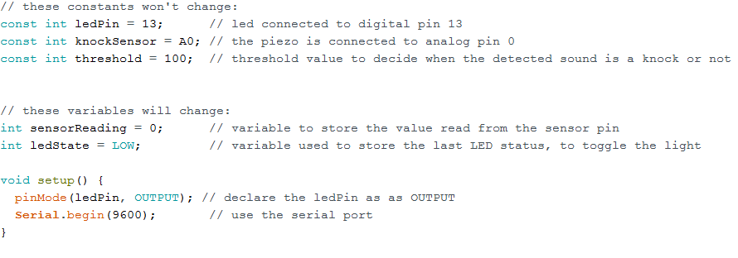
Analogue in and Serial out: Knock Sensor

Slide 13
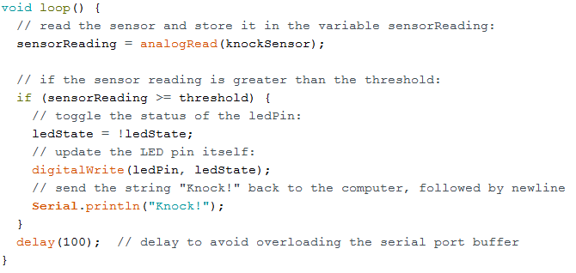
Analogue in and Serial out: Knock Sensor

Slide 14
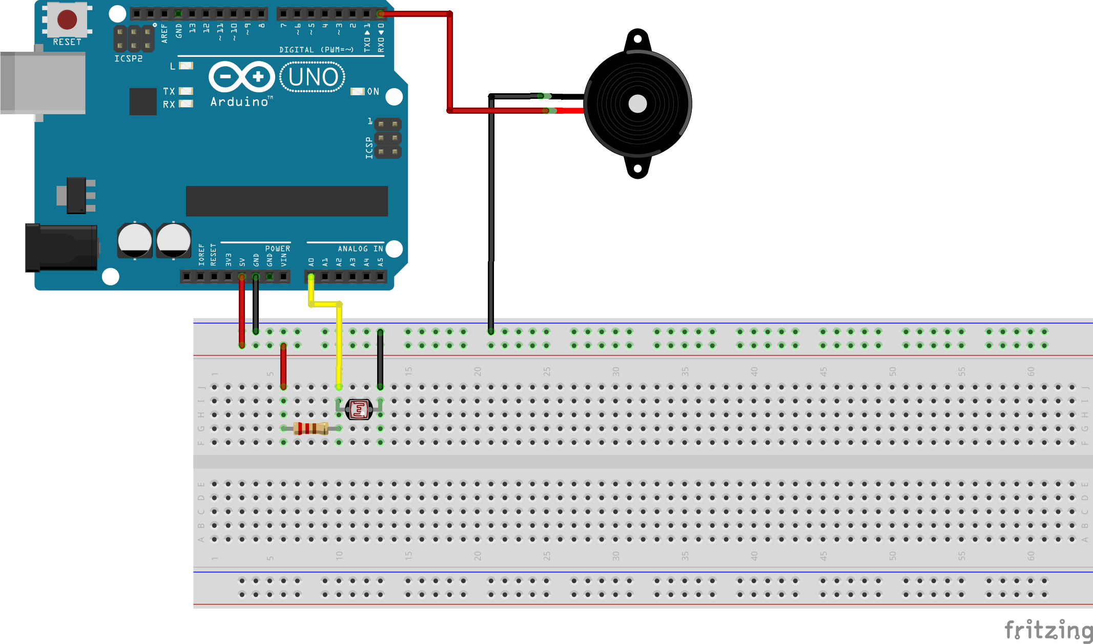
Other Inputs and Outputs: LDR and Piezo

Slide 15
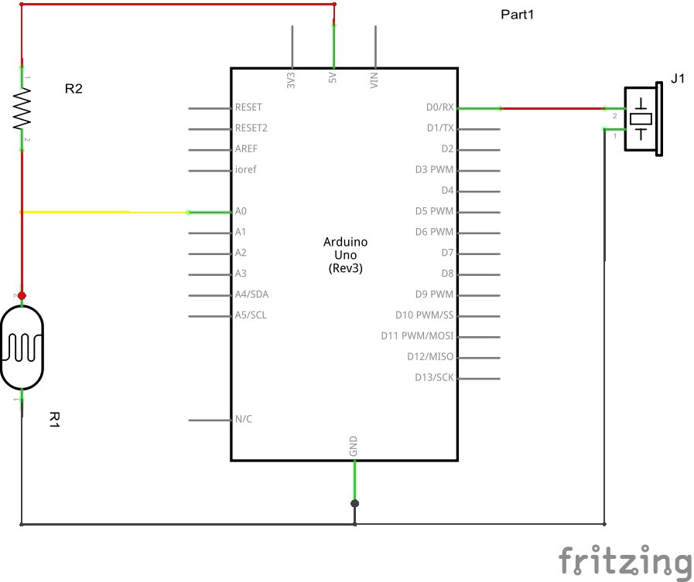
Other Inputs and Outputs: LDR and Piezo

Slide 16
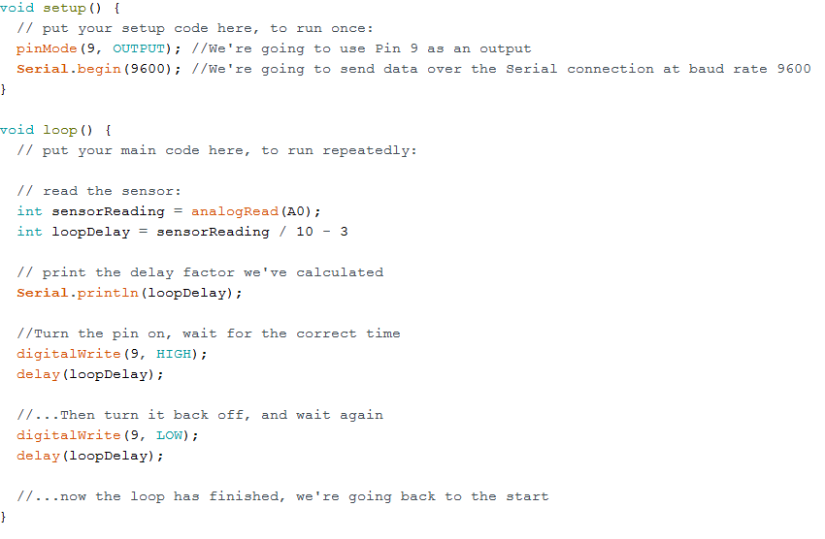

Slide 17
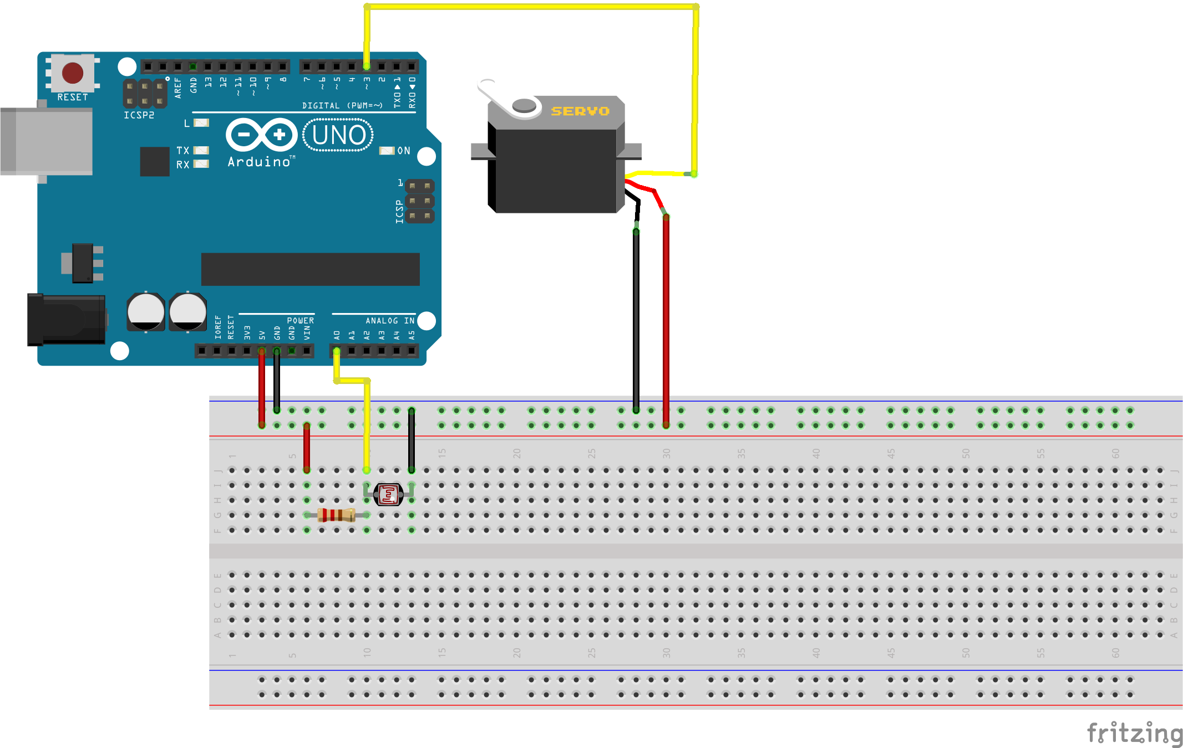
Using Libraries: Servo motors

Slide 18
